Slide 1


KONERU LAKSHMAIAH EDUCATION FOUNDATION
PROJECT REVIEW – 3 | TEAM 16 | SEC 10
Lost & Found
Campus Tracker
A smart, location-aware recovery network for the campus community
M. Harshika
Ch. Madhulika
B. Neha
2520090047
2520090056
2520090013
Database Systems Engineering and Distributed Backend Development (25CS1302E) • 2026–2027

Slide 2


STEP 1
Project Overview
THE PROBLEM
OUR SOLUTION
Notices and WhatsApp groups are scattered
One central platform to report lost & found items
No record of where items were lost
Map view showing loss hotspots
Anyone can claim an item
Automatic matching with a confidence score
Matching is manual, item by item
Private-detail ownership verification
TECH STACK
HTML5 · CSS3 · JS
Bootstrap
Spring Boot
REST APIs
MySQL + JPA
Lost & Found Campus Tracker · Team 16, Sec 10 · Review 3
2

Slide 3





STEP 2
Front-End: User Journey
How a user moves through the Bootstrap-based interface
1
2
3
4
5
Home
Login
Report
Dashboard
Map
Search, recent items, map preview
Role-based access with validation
Lost / found form with image upload
Live status & match alerts
Hotspots of reported locations
COMMON TO EVERY PAGE
Reusable header/footer • Responsive Bootstrap grid • Inline form validation • fetch() calls to REST APIs
Lost & Found Campus Tracker · Team 16, Sec 10 · Review 3
3

Slide 4


STEP 3
Frontend Modules & Features
Report Lost / Found
Search & Filters
My Dashboard
Category, description, location, date & photo
Find items by category, location or status
Track lifecycle status, view match alerts
Used by: Student, Staff
Used by: Everyone
Used by: Student, Staff
Campus Map
Verification
Admin Panel
Hotspot view of frequently reported areas
Enter private details to claim an item
Review reports, resolve disputes, remove duplicates
Used by: Everyone
Used by: Claimant
Used by: Admin
Lost & Found Campus Tracker · Team 16, Sec 10 · Review 3
4

Slide 5
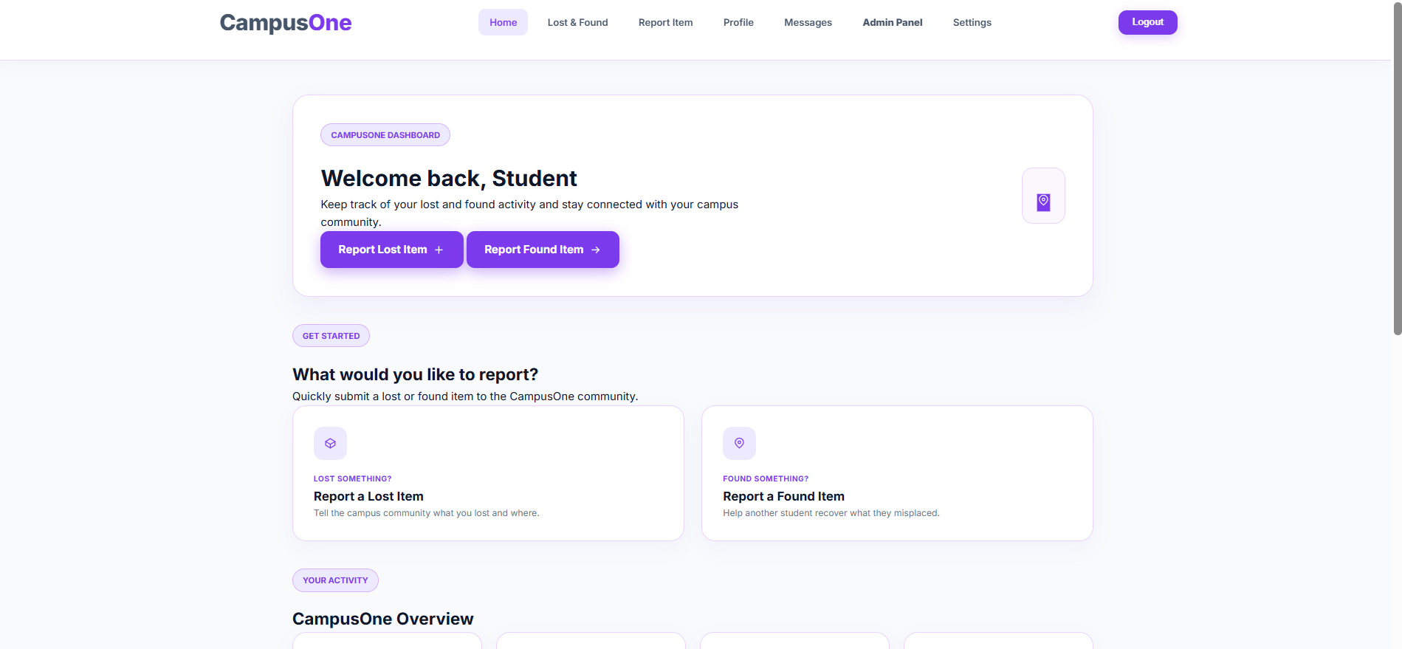
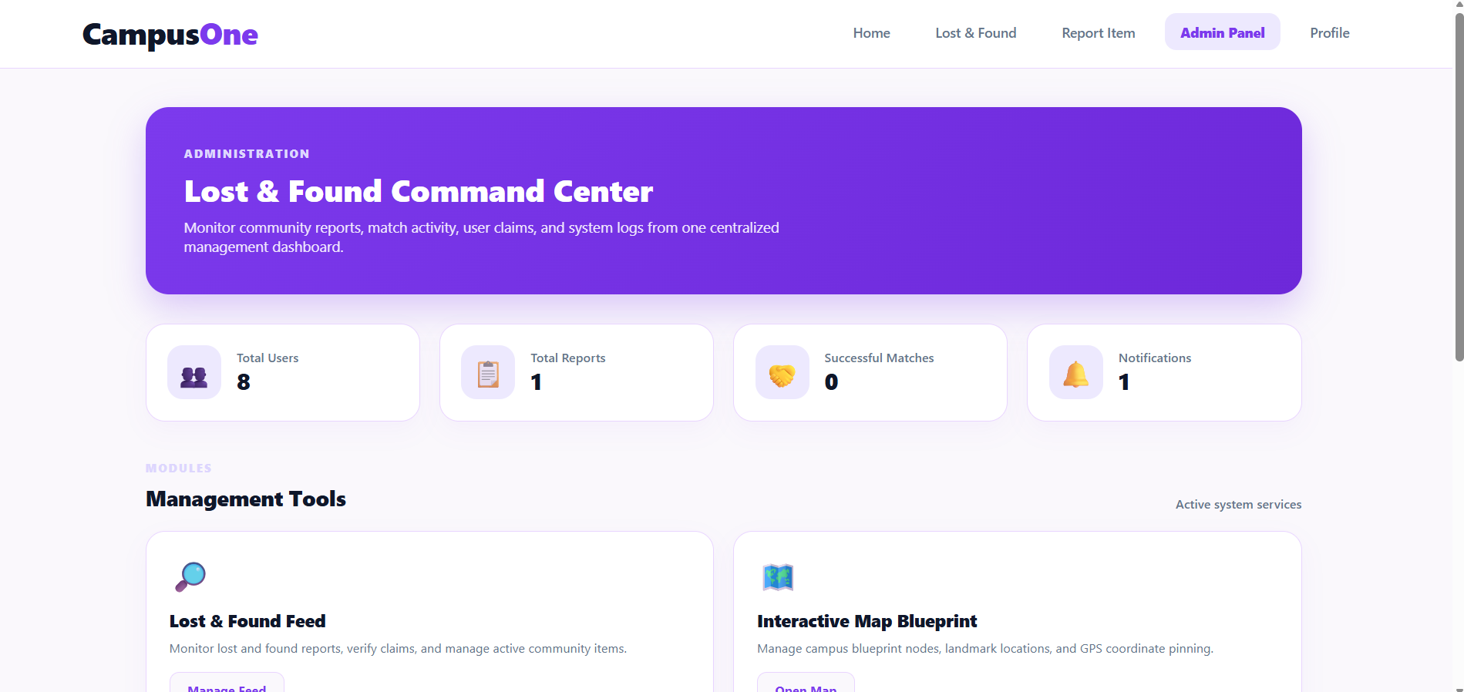
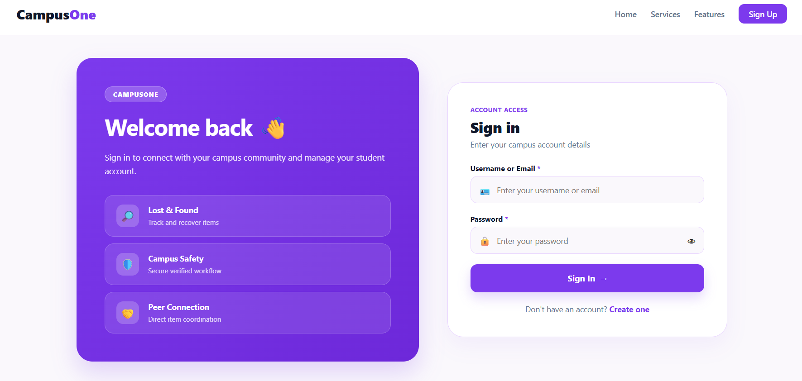
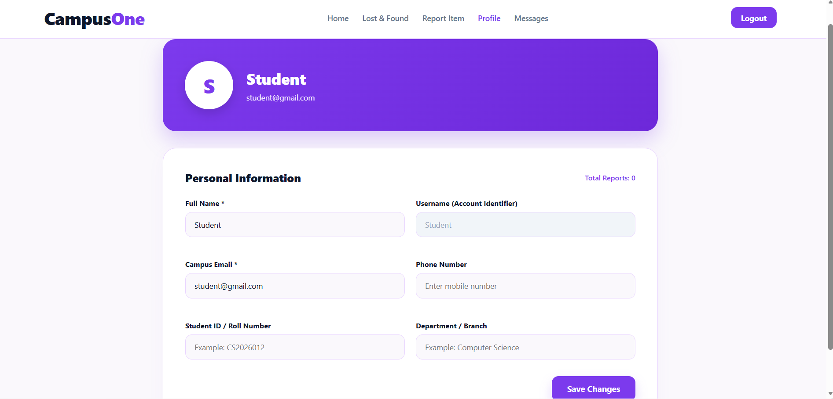
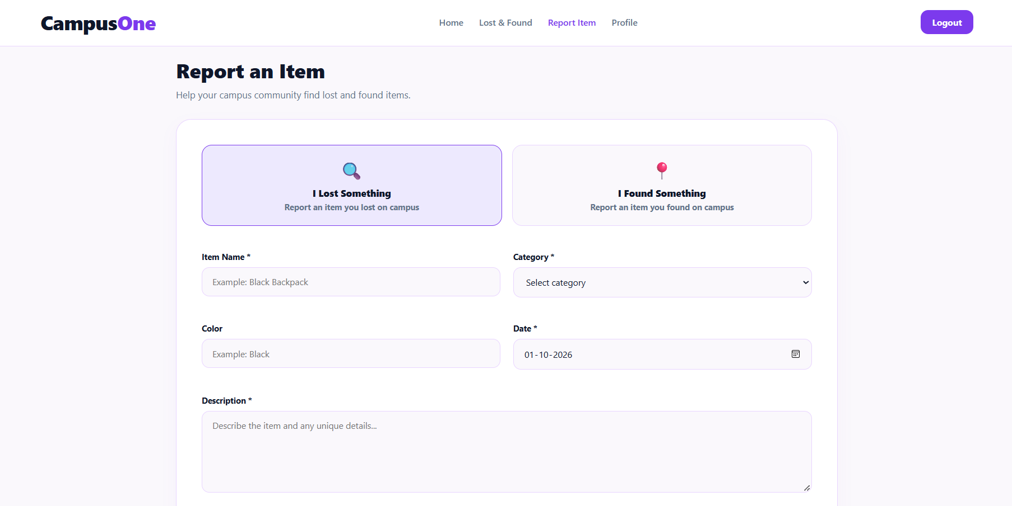
STEP 4
Frontend Screenshots
Insert Dashboard (main)
screenshot here
Insert Home Page
screenshot here
Insert Login
screenshot here
Insert Report Form
screenshot here
Insert Admin Panel
screenshot here
Lost & Found Campus Tracker · Team 16, Sec 10 · Review 3
5

Slide 6
STEP 5
System Architecture: Frontend → Backend → Database
Presentation
Browser
Pages & Forms
Bootstrap Grid
Form Validation
fetch() API Client
HTTP · JSON
Application
Spring Boot
Controller
Service
Repository
Entity
REST endpoints
Matching & rules
Spring Data JPA
Maps to tables
JPA · JDBC
Data
MySQL
users
item_reports
location_log
matches
verification
notifications
Lost & Found Campus Tracker · Team 16, Sec 10 · Review 3
6

Slide 7
STEP 6
Request Data Flow: Reporting a Lost Item
BROWSER
BROWSER
SPRING BOOT
SPRING BOOT
MYSQL
BROWSER
1
2
3
4
5
6
User submits form
POST /api/reports
Controller
Service
JPA INSERT
JSON response
Inline validation, then fetch()
JSON body sent to server
Maps JSON to DTO, validates
Saves report, runs matching
Row stored in item_reports
Page re-renders with status
REQUEST · POST /api/reports
RESPONSE · 201 CREATED
{
"type": "lost",
"category": "Wallet",
"location": "Library",
"userId": 12
}
{
"reportId": 58,
"status": "OPEN",
"possibleMatches": 2
}
Lost & Found Campus Tracker · Team 16, Sec 10 · Review 3
7

Slide 8


STEP 7
Database Design
Why a relational design?
6
Users, reports, matches and verifications are naturally linked records
relational tables
Constraints keep every report, match and alert valid
PK / FK keys link every table
Each fact is stored once and referenced, not copied
MySQL via Spring Data JPA
Supports joins for matching and hotspot insights
Lost & Found Campus Tracker · Team 16, Sec 10 · Review 3
8

Slide 9
STEP 8
ER Diagram / Database Schema
USER
ITEM_REPORT
LOCATION_LOG
PK user_id
name, email
role, phone
PK report_id · FK user_id
type, category, location
date_time, image_url, status
PK loc_id
FK report_id
latitude, longitude
1 : N
1 : N
1 : N
1 : N
NOTIFICATION
MATCH
VERIFICATION
PK notif_id
FK user_id, FK match_id
sent_at
PK match_id
FK lost_report_id
FK found_report_id
confidence_score, status
PK verify_id
FK match_id
private_detail_hash
verified_by
N : 1
1 : 1
Lost & Found Campus Tracker · Team 16, Sec 10 · Review 3
9

Slide 10

STEP 9
Tables and Their Purpose
CORE DATA
PROCESS
SUPPORT
users
matches
notifications
Student, staff & admin accounts
Lost–found pairs with confidence score
Email alerts for possible matches
item_reports
verification
location_log
Lost / found item details and status
Private-detail hash and verifier
Latitude / longitude for the map
Lost & Found Campus Tracker · Team 16, Sec 10 · Review 3
10

Slide 11
STEP 10
Keys and Relationships
FOREIGN KEY → PRIMARY KEY
Primary key
item_reports.user_id
users.user_id
Uniquely identifies a row
matches.lost_report_id
item_reports.report_id
Foreign key
Points to another table's primary key
matches.found_report_id
item_reports.report_id
verification.match_id
matches.match_id
Referential integrity
No match or alert can point to a missing row
notifications.match_id
matches.match_id
Lost & Found Campus Tracker · Team 16, Sec 10 · Review 3
11

Slide 12




STEP 11
Database Operations (CRUD)
CREATE
READ
UPDATE
DELETE
SQL INSERT
SQL SELECT
SQL UPDATE
SQL DELETE
REST POST
REST GET
REST PUT
REST DELETE
Submit a lost / found report
View items, matches, dashboard
Change status → Verified / Recovered
Admin removes duplicate reports
Lost & Found Campus Tracker · Team 16, Sec 10 · Review 3
12

Slide 13
STEP 12
Sample SQL Queries
1
All reported lost items
SELECT * FROM item_reports
WHERE type = 'lost';
2
Each user's reports and status
SELECT u.name, r.category, r.status
FROM users u
JOIN item_reports r
ON r.user_id = u.user_id;
3
Best matches first
SELECT l.category, m.confidence_score
FROM matches m
JOIN item_reports l
ON l.report_id = m.lost_report_id
ORDER BY m.confidence_score DESC;
Lost & Found Campus Tracker · Team 16, Sec 10 · Review 3
13

Slide 14
STEP 14
Conclusion and Next Steps
WHAT WE ACHIEVED
NEXT STEPS
One platform for campus lost & found
1
Improve matching accuracy
2
Integrate Google Maps hotspots
Linked relational database with keys and constraints
3
Add email match alerts
4
More validation & testing
Frontend connected to the backend through REST APIs
5
UI/UX polish
Lost & Found Campus Tracker · Team 16, Sec 10 · Review 3
15

Slide 15
Thank You

